Slide 1
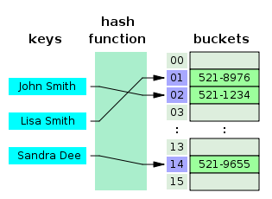
COSC 222 Data Structures
Yves Lucet
CC BY-SA 3.0 https://en.wikipedia.org/wiki/Skip_list#/media/File:Skip_list_add_element-en.gif
"Hash table 3 1 1 0 1 0 0 SP" by Jorge Stolfi - Own work. Licensed under CC BY-SA 3.0 via Commons - https://commons.wikimedia.org/wiki/File:Hash_table_3_1_1_0_1_0_0_SP.svg#/media/File:Hash_table_3_1_1_0_1_0_0_SP.svg

Slide 3
Evaluations
MAT2
iMAT2 avg 60%
tMAT2 avg 76%
RAT3
iRAT3 avg 56% (2018 66%)
tRAT3 avg 83% (2018 90%)
Appeal granted on Q4, 5, 11

Slide 4
tRAT3 appeals granted
Q4: height of tree is 4 (number of edges from longest path from a leave to root). Appeal granted to 27, 19, 16, 24, 10, 23, 2
Q11: 14 appeal granted with an excellent answer: “This method can only work in O(log n) time if both heaps are already complete heaps. Otherwise, the resulting "heap" will not have all the necessary qualifications of a heap.”

Slide 5
Efficiently merging 2 heaps that contain a total of n elements takes
O(n)
O(n log n)
O(n²)
O(1)
O(log n)
Notes:
E: O(log n) is selected as the right answer
The answer is false and should be appealed.
- Given 2 perfect binary trees, one can build a heap in O(log n): create root node with e, put h1 on left child, h2 on right child, do a down-heap. Then you have a heap that is also a perfect binary tree.
- Given 2 heaps the challenge is to build a complete binary tree when the 2 heaps could have different heights. Take h1 containing 10, 11, 12, 13; h2 containing 20, 21, and e = 5. Then building a tree as above results in a non complete binary tree.
In that case, the best one can do simply is O(n) using bottom-up heap building; O(n log n) occurs if one inserts one element at a time into h1 (if h1.size() > h2.size()) and inserting e. However, assuming heap 1 has size n and heap 2 size k, the best algorithm runs in O(k + (log n)(log k)) for an array implementation and in O((log n)(log k)) for a pointer-based implementation by https://link.springer.com/content/pdf/10.1007/BF00264229.pdf
Solutions:
https://www.baeldung.com/cs/merge-two-max-heaps
https://www.geeksforgeeks.org/merge-two-binary-max-heaps/
https://link.springer.com/content/pdf/10.1007/BF00264229.pdf

Slide 6
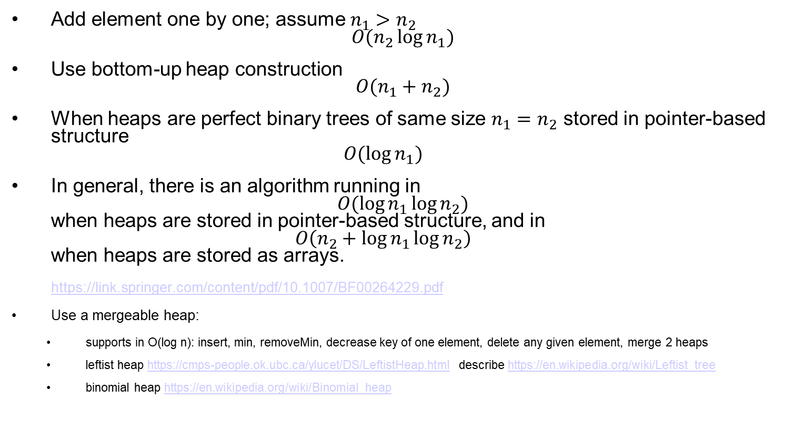

Heap 1 h1 size $n_{1}$ Heap 2 h2 size $n_{2}$
Add element one by one; assume $n_{1}>n_{2}$ $O(n_{2}\log{n_{1}})$
Use bottom-up heap construction $O(n_{1}+n_{2})$
When heaps are perfect binary trees of same size $n_{1}=n_{2}$ stored in pointer-based structure $O(\log{n_{1}})$
In general, there is an algorithm running in $O(\log{n_{1}\log{n_{2}})}$ when heaps are stored in pointer-based structure, and in $O\left(n_{2}+\log{n_{1}\log{n_{2}}}\right)$ when heaps are stored as arrays. https://link.springer.com/content/pdf/10.1007/BF00264229.pdf
Use a mergeable heap:
supports in O(log n): insert, min, removeMin, decrease key of one element, delete any given element, merge 2 heaps
leftist heap https://cmps-people.ok.ubc.ca/ylucet/DS/LeftistHeap.html describe https://en.wikipedia.org/wiki/Leftist_tree
binomial heap https://en.wikipedia.org/wiki/Binomial_heap

Slide 7
Efficiently merging 2 heaps that contain a total of n elements takes
O(n)
O(n log n)
O(n²)
O(1)
O(log n)
Accepted answers:
Clarification required [Only 1 team asked for clarification and figured out the perfect heap case of O(log n)]
Notes:
E: O(log n) is selected as the right answer
The answer is false and should be appealed.
- Given 2 perfect binary trees, one can build a heap in O(log n): create root node with e, put h1 on left child, h2 on right child, do a down-heap. Then you have a heap that is also a perfect binary tree.
- Given 2 heaps the challenge is to build a complete binary tree when the 2 heaps could have different heights. Take h1 containing 10, 11, 12, 13; h2 containing 20, 21, and e = 5. Then building a tree as above results in a non complete binary tree.
In that case, the best one can do simply is O(n) using bottom-up heap building; O(n log n) occurs if one inserts one element at a time into h1 (if h1.size() > h2.size()) and inserting e. However, assuming heap 1 has size n and heap 2 size k, the best algorithm runs in O(k + (log n)(log k)) for an array implementation and in O((log n)(log k)) for a pointer-based implementation by https://link.springer.com/content/pdf/10.1007/BF00264229.pdf
Solutions:
https://www.baeldung.com/cs/merge-two-max-heaps
https://www.geeksforgeeks.org/merge-two-binary-max-heaps/
https://link.springer.com/content/pdf/10.1007/BF00264229.pdf

Slide 8
Bottom-up heap construction
7 6 5 4 3 2 1
Build a min heap
7
Put everything in a heap in order of elements
6
5
4
3
2
1
7 | 6 | 5 | 4 | 3 | 2 | 1
https://www.w3spot.com/2020/10/building-binary-heap-in-on-worst-time.html
https://www.geeksforgeeks.org/time-complexity-of-building-a-heap/
Notes:
11:7am

Slide 9
Bottom-up heap construction
7 6 5 4 3 2 1
Build a min heap
7
Level 2: no action (leaf nodes have no children so they satisfy the heap property)
6
5
4
3
2
1
7 | 6 | 5 | 4 | 3 | 2 | 1
https://www.w3spot.com/2020/10/building-binary-heap-in-on-worst-time.html
https://www.geeksforgeeks.org/time-complexity-of-building-a-heap/

Slide 10
Bottom-up heap construction
7 6 5 4 3 2 1
Build a min heap
7
Level 1: 1 shift down
6
5
4
3
2
1
7 | 6 | 5 | 4 | 3 | 2 | 1
https://www.w3spot.com/2020/10/building-binary-heap-in-on-worst-time.html
https://www.geeksforgeeks.org/time-complexity-of-building-a-heap/

Slide 11
Bottom-up heap construction
7 6 5 4 3 2 1
Build a min heap
7
Level 1: 1 shift down
6
1
4
3
2
5
7 | 6 | 1 | 4 | 3 | 2 | 5
https://www.w3spot.com/2020/10/building-binary-heap-in-on-worst-time.html
https://www.geeksforgeeks.org/time-complexity-of-building-a-heap/

Slide 12
Bottom-up heap construction
7 6 5 4 3 2 1
Build a min heap
7
Level 1: 1 shift down
6
1
4
3
2
5
7 | 6 | 1 | 4 | 3 | 2 | 5
https://www.w3spot.com/2020/10/building-binary-heap-in-on-worst-time.html
https://www.geeksforgeeks.org/time-complexity-of-building-a-heap/

Slide 13
Bottom-up heap construction
7 6 5 4 3 2 1
Build a min heap
7
Level 1: 1 shift down
3
1
4
6
2
5
7 | 3 | 1 | 4 | 6 | 2 | 5
https://www.w3spot.com/2020/10/building-binary-heap-in-on-worst-time.html
https://www.geeksforgeeks.org/time-complexity-of-building-a-heap/

Slide 14
Bottom-up heap construction
7 6 5 4 3 2 1
Build a min heap
7
Level 0: 2 shift down
3
1
4
6
2
5
7 | 3 | 1 | 4 | 6 | 2 | 5
https://www.w3spot.com/2020/10/building-binary-heap-in-on-worst-time.html
https://www.geeksforgeeks.org/time-complexity-of-building-a-heap/

Slide 15
Bottom-up heap construction
7 6 5 4 3 2 1
Build a min heap
1
Level 0: 2 shift down
3
7
4
6
2
5
1 | 3 | 7 | 4 | 6 | 2 | 5
https://www.w3spot.com/2020/10/building-binary-heap-in-on-worst-time.html
https://www.geeksforgeeks.org/time-complexity-of-building-a-heap/

Slide 16
Bottom-up heap construction
7 6 5 4 3 2 1
Build a min heap
1
Level 0: 2 shift down
3
7
4
6
2
5
1 | 3 | 7 | 4 | 6 | 2 | 5
https://www.w3spot.com/2020/10/building-binary-heap-in-on-worst-time.html
https://www.geeksforgeeks.org/time-complexity-of-building-a-heap/

Slide 17
Bottom-up heap construction
7 6 5 4 3 2 1
Build a min heap
1
Level 0: 2 shift down
3
2
4
6
7
5
1 | 3 | 2 | 4 | 6 | 7 | 5
https://www.w3spot.com/2020/10/building-binary-heap-in-on-worst-time.html
https://www.geeksforgeeks.org/time-complexity-of-building-a-heap/

Slide 18
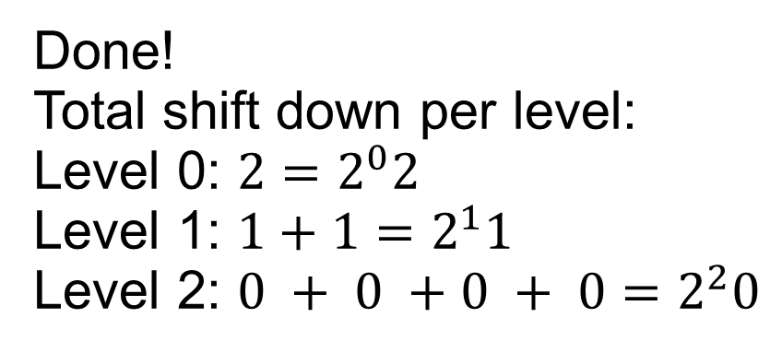
Bottom-up heap construction
7 6 5 4 3 2 1
Build a min heap
1
Done!
Total shift down per level:
Level 0: $2=2^{0}2$
Level 1: $1+1=2^{1}1$
Level 2: $0 + 0 +0 + 0=2^{2}0$
3
2
4
6
7
5
1 | 3 | 2 | 4 | 6 | 7 | 5
https://www.w3spot.com/2020/10/building-binary-heap-in-on-worst-time.html
https://www.geeksforgeeks.org/time-complexity-of-building-a-heap/

Slide 19
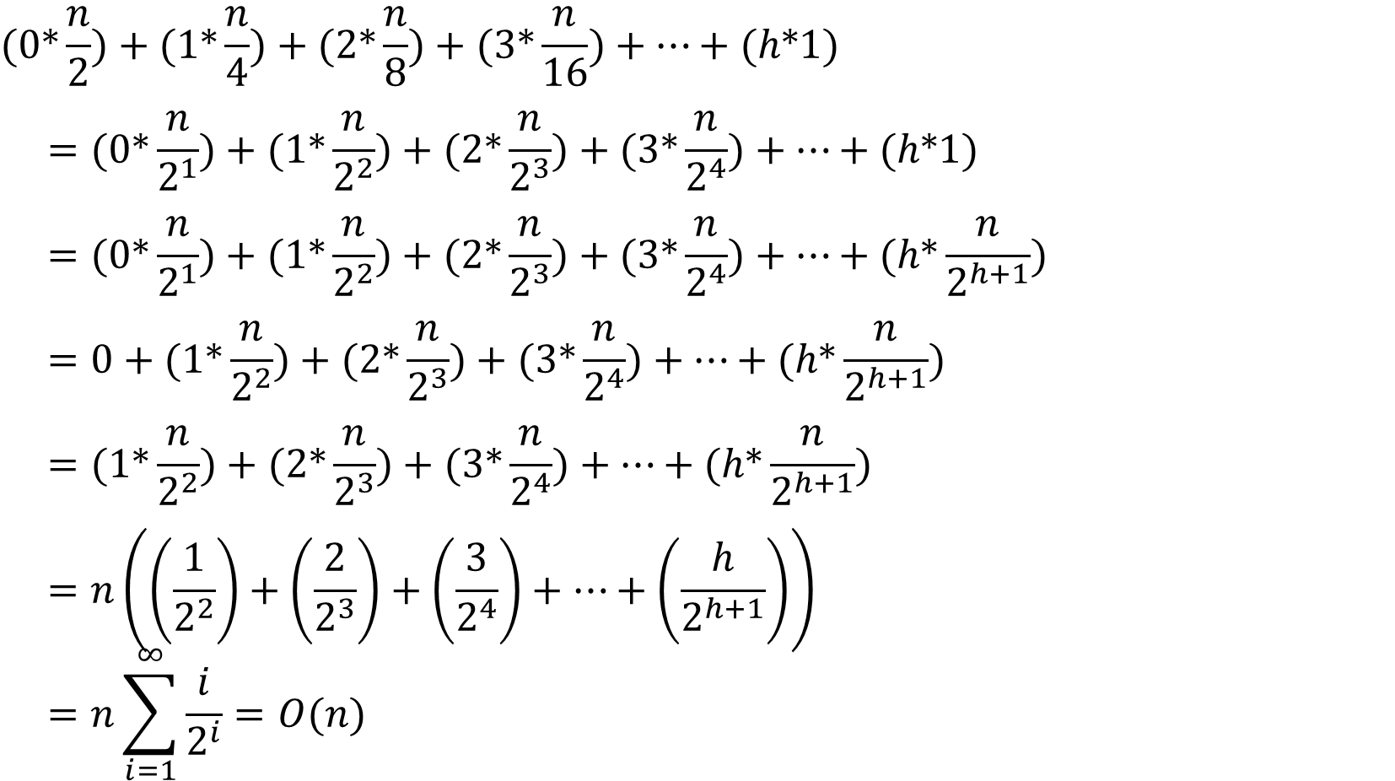
Bottom-up heap construction
$$=n\left(\left(\frac{1}{2^{2}}\right)+\left(\frac{2}{2^{3}}\right)+\left(\frac{3}{2^{4}}\right)+…+\left(\frac{h}{2^{h+1}}\right)\right) \\ =n\sum_{i=1}^{∞}{\frac{i}{2^{i}}}=O(n)=(1∗\frac{n}{2^{2}})+(2∗\frac{n}{2^{3}})+(3∗\frac{n}{2^{4}})+…+(h∗\frac{n}{2^{h+1}})=0+(1∗\frac{n}{2^{2}})+(2∗\frac{n}{2^{3}})+(3∗\frac{n}{2^{4}})+…+(h∗\frac{n}{2^{h+1}})=(0∗\frac{n}{2^{1}})+(1∗\frac{n}{2^{2}})+(2∗\frac{n}{2^{3}})+(3∗\frac{n}{2^{4}})+…+(h∗\frac{n}{2^{h+1}})=(0∗\frac{n}{2^{1}})+(1∗\frac{n}{2^{2}})+(2∗\frac{n}{2^{3}})+(3∗\frac{n}{2^{4}})+…+(h∗1)(0∗\frac{n}{2})+(1∗\frac{n}{4})+(2∗\frac{n}{8})+(3∗\frac{n}{16})+…+(h∗1)$$
$$=n\sum_{i=1}^{∞}{\frac{i}{2^{i}}}=O(n)$$
https://www.w3spot.com/2020/10/building-binary-heap-in-on-worst-time.html
https://www.geeksforgeeks.org/time-complexity-of-building-a-heap/
Notes:
Use geometric series \sum_(i=0)^\infty x^i = 1/(1-x)
Derive to obtain \sum_(i=0)^\infty i x^i = x/(1-x)^2
Then use x = 1/2 to obtain
\sum_i=0^\infty i/2^i = 1/2 / (1-1/2)^2 = 2 = O(1)

Slide 20
Readings
Hash table
Separate chaining
Open addressing with linear probing
Skip list
Notes:
11:20am

Slide 21
Hash table
Diving into the details

Slide 22
Array to Hash table
Hash function
i
o
j
i
Hash
code
Compression function
Direct access:
A[i] is stored at base address + i * size(element)

Slide 23
Hash Table
Table
Hash function
Hash code: spread the values; independent of n
Compression function: returns values in [0, n-1]
Key idea: Generalize arrays from (i, a[i]) with i integer in [0,N-1] and a[i] object to (k, e) where k, e are objects

Slide 24
Hash Table: Generalize Array
Pro:
Expected O(1) for read, edit, insert, delete
Con:
Data is not sorted e.g. range queries are difficult
Only expected time, not worst-case time

Slide 25
Hashing a string
i = sum(asc(s[k]), k=0..k-1)
k = i mod N
Problem: hash(“abc”) = hash(“bac”) = hash(“cab”)

Slide 26
Hashing a string
Polynomial hash code i = asc(s[0]) * a^{k-1} + asc(s[1]) * a^{k-2} + …. + asc(s[k-2]) * a + asc(s[k-1]) asc(c) returns the ASCII code of character c
MAD method: Multiply-Add-and-Divide as compression function k = [ ( a * i + b) mod p ] mod N p prime number larger than N a, b are integers randomly chosen in [0, p-1] a > 0 N is the size of the bucket array

Slide 27
Warning
Finding a perfect hash function for N objects is NP-hard

Slide 28
Collisions: Open Addressing single array
Linear probing: if A[i] occupied, try A[(i+1) mod N], A[(i+2) mod N], … may lead to clustering and reduce performance
Quadratic probing: if A[i] occupied, try A[(i+1²) mod N], A[(i+2²) mod N], … tries to avoid clustering but
May be stuck in infinite loop
May skip some elements of the table
Proven to work when N is prime number and table less than half full
https://people.ok.ubc.ca/ylucet/DS/ClosedHash.html
Notes:
Demo of linear probing in https://people.ok.ubc.ca/ylucet/DS/ClosedHash.html

Slide 29
Collisions: Separate Chaining array of lists
Table is array of list
A[i].add(e) adds elements that collides to same bucket
Only items with same key are read when searching [Open addressing may read items with different keys when clusters overlap]
Can store more elements than N
Deletion actually removes the item
Drawback: use 2 data structures instead of a single array
https://people.ok.ubc.ca/ylucet/DS/OpenHash.html

Slide 30
Skip list
Diving into the details
Notes:
11:30am

Slide 31
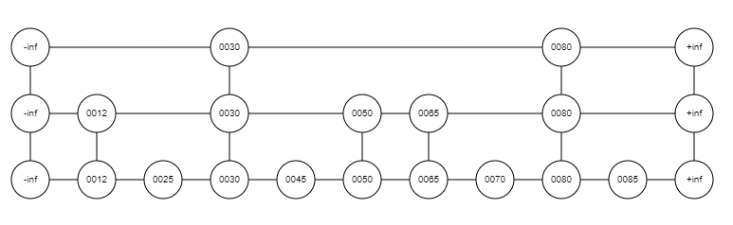
Skip list

Slide 32
Skip List: Generalize a sorted array
Pros:
O(log n): Insert, remove
Keep items sorted: Allow ranged queries
Easy to find top 10 smallest/largest elements
Space is O(n) expected
Cons:
Expected time/space
Randomized so no 2 insertion lead to same skiplist
https://cmps-people.ok.ubc.ca/ylucet/DS/SkipList.html

Slide 33


Application
Notes:
11:35am-12:05pm: 30min

Slide 34
Dashboard
Linear probing: Draw the 11- entry hash table that results from using the hash function, h ( i ) = ( 3i + 5 ) mod 11, to hash the keys 12, 44, 13, 88, 23, 94, 11, 39, 20, 16, and 5, assuming collisions are handled by linear probing.

Slide 36
Write Answer on Board
Separate Chaining: Draw the 11- entry hash table that results from using the hash function, h ( i ) = ( 3i + 5 ) mod 11, to hash the keys 12, 44, 13, 88, 23, 94, 11, 39, 20, 16, and 5, assuming collisions are handled by chaining.

Slide 38
What is the best data structure for returning all strings between “Metro” and “Triage” in a set of strings
Queue
Stack
Skip list
Priority queue
Hash table
O(log n + d)
What is the time complexity?
Notes:
C. Skip list (range query). O(log n + d) where there are d strings in the range.

Slide 39
What is the best data structure for finding student information based on their student ID
Queue
Stack
Skip list
Priority queue
Hash table
O(1)
What is the time complexity?
Notes:
E. Hash table. Student IDs are not ordered in any meaningful way. O(1) expected time to find

Slide 40
What is the best data structure for Listing the top 10% of best performing students based on GPA
Queue
Stack
Skip list
Priority queue
Hash table
O(d) = O(n)
O(d log n) = O(n log n)
What is the time complexity?
Notes:
C. Skip list. GPA are ordered and this is a range query. Keep pointer at top for O(d) where d = n/10 so O(n)
D. Priority queue. Possible too; do a removeMin() till the 10% students are found. O(d log n) so O(n log n)

Slide 41
Worst-case
What is the worst-case for finding an element in a hash-table storing N elements when open addressing is used?
O(1)
O(log N)
O(N)
O(N Log N)
O(N²)
O(N)
Notes:
C: O(N). The worst-case occurs when the hash function is constant f(k)=0

Slide 42
Worst-case
What is the worst-case for finding an element in a hash-table storing N elements when separate chaining is used?
O(1)
O(log N)
O(N)
O(N Log N)
O(N²)
O(N)
Notes:
C: O(N). The worst-case occurs when the hash function is constant f(k)=0. The hash-table in that case is a list.

Slide 43

Suppose that each row of an n×n array A consists of 1’ s and 0’ s such that, in any row of A, all the 1’ s come before any 0’ s in that row. Assuming A is already in memory, describe a method running in $O ( n log⁡n )$time ( not $O ( n^{2} )$time) for counting the number of 1’ s in A.
Notes:
Write solution on white board for each team
C-10.58: binary search on each row

Slide 44
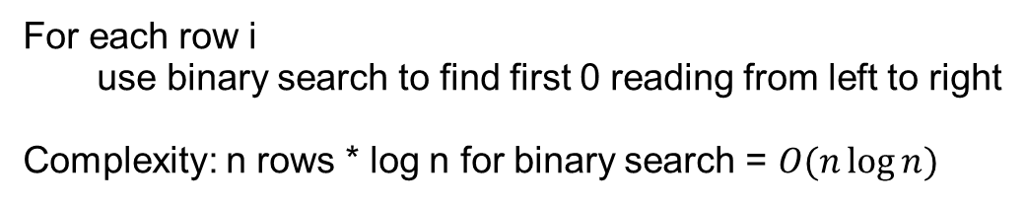
1 | 1 | 1 | 0 | 0 | 0 | 0 | 0
1 | 0 | 0 | 0 | 0 | 0 | 0 | 0
1 | 1 | 1 | 1 | 1 | 1 | 0 | 0
1 | 1 | 0 | 0 | 0 | 0 | 0 | 0
1 | 1 | 1 | 1 | 1 | 1 | 1 | 1
0 | 0 | 0 | 0 | 0 | 0 | 0 | 0
1 | 1 | 1 | 1 | 0 | 0 | 0 | 0
1 | 1 | 1 | 1 | 1 | 0 | 0 | 0
1 | 1 | 0 | 0 | 0 | 0 | 0 | 0
For each row i
use binary search to find first 0 reading from left to right
Complexity: n rows * log n for binary search = $O(n\log{n})$

Slide 45
Summary
Array
List
Stack, Queue, Deque
Priority Queue
Heap
Hash Table
Open addressing or
Separate Chaining
Skip list
Notes:
12:15pm

Slide 46
Reading: Union Find / Disjoint Set
Graph representation
Adjacency matrix
Adjacency list
Dijkstra’s algorithm for shortest path
Manipulate several examples at
https://cmps-people.ok.ubc.ca/ylucet/DS/Dijkstra.html

Slide 47
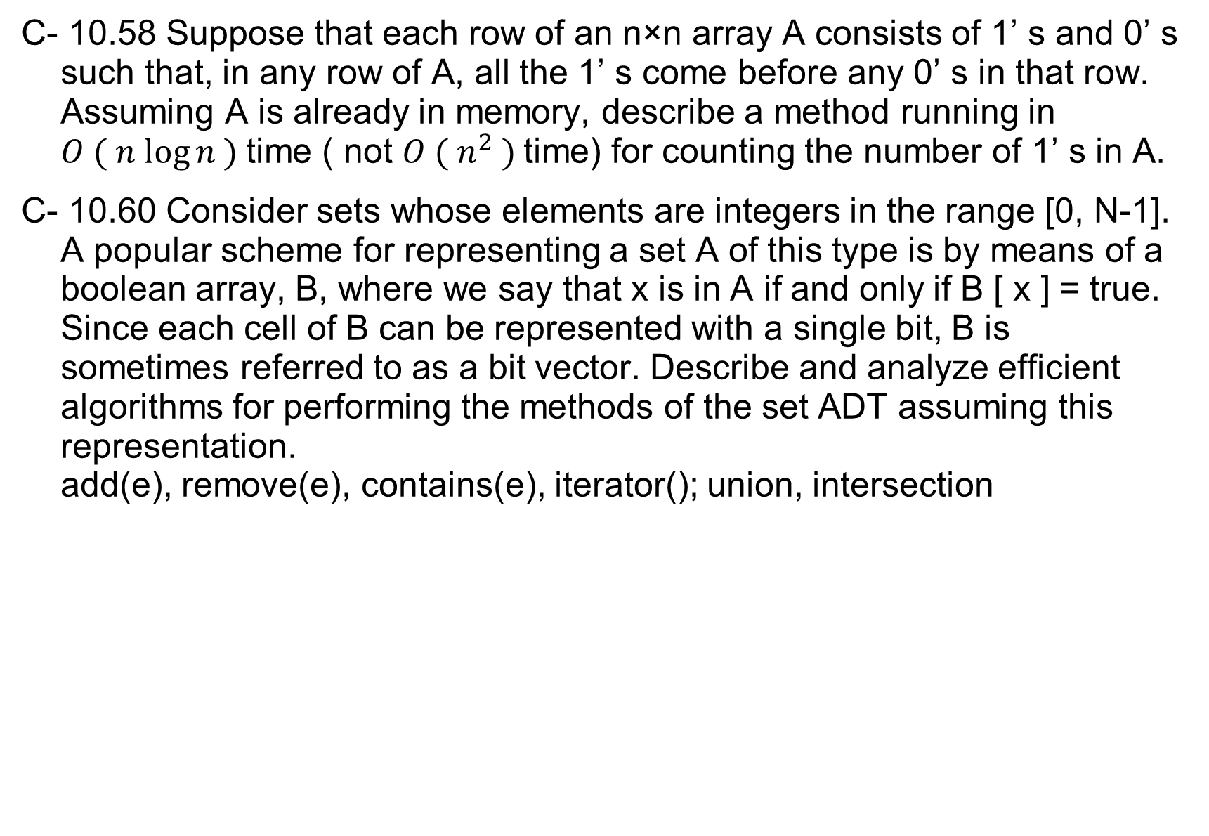
C- 10.58 Suppose that each row of an n×n array A consists of 1’ s and 0’ s such that, in any row of A, all the 1’ s come before any 0’ s in that row. Assuming A is already in memory, describe a method running in $O ( n log⁡n )$time ( not $O ( n^{2} )$time) for counting the number of 1’ s in A.
C- 10.60 Consider sets whose elements are integers in the range [0, N-1]. A popular scheme for representing a set A of this type is by means of a boolean array, B, where we say that x is in A if and only if B [ x ] = true. Since each cell of B can be represented with a single bit, B is sometimes referred to as a bit vector. Describe and analyze efficient algorithms for performing the methods of the set ADT assuming this representation. add(e), remove(e), contains(e), iterator(); union, intersection
Notes:
Write solution on white board for each team
C-10.58: binary search on each row
C-10.60: loop on boolean array. Complexity: add O(1), remove O(1), iterator O(n), union O(n), intersection O(n). The structure is inefficient when holding sparse data i.e. when it has very few elements.
A different (but same complexity) solution converts to bits and use bit operators:
union: p OR q
intersection: p AND q
subtraction: p AND not q

Slide 48
Readings
Date | Files
Sep 13 | 1 readings-Java-UnitTesting.txt 1 readings-Java-UnitTesting.txt
Sep 15 | 2 readings-complexity.txt
Sep 20 | 3 readings-Array-List.txt
Sep 27 | 5_6 readings-recursion-stack-queue.txt
Oct 4 | 7 readings-iterator.txt
Oct 11 | 8_9 readings Trees-PQ.txt
Oct 13 | 10 reading hash skiplist.txt
Oct 18 | 11 readings Dijkstra.txt
Oct 20 | 12 reading union-find.txt
Oct 27 | 14 readings search trees.txt
Nov 17 | 15 reading (2,4)-B trees.txt
The readings should be done before the indicated date with questions posted on Ms Teams.

